Slide 1
BASICS IN GRAPHICS DESIGN
INTRODUCTION TO GRAPHIC DESIGN
COURSE CODE: CSD 117
Lecture 1

Slide 2
Definition
Graphic design is a craft where professionals create visual content to communicate messages.
By applying visual hierarchy and page layout techniques, designers use typography and pictures to meet user's’ specific needs and focus on the logic of displaying elements in interactive designs, to optimize the user experience.

Slide 3
About Graphic Design
It covers a range of activities including poster design, book design, business card designs, brand package designs, logo creation etc.
Graphic design in this sense concerns aesthetic appeal and marketing. Graphic designers attract viewers using images, color and typography.

Slide 4
Graphic Design is emotional
You must design with interactive software eg Adobe Suite, Phone apps etc,
Graphic design revolves around old principles. It’s crucial that you strike the right chord with users from their first glance—hence graphic design’s correspondence with emotional design.
As a graphic designer, then, you should have a firm understanding of color theory and how vital the right choice of color scheme is. Color choices must reflect not only the organization (e.g., blue suites banking, health etc) but also users’ expectations (e.g., red for alerts; green for notifications to proceed).
You should design with an eye for how elements match the tone (e.g., sans-serif fonts for excitement or happiness).
You also need to design for the overall effect, and note how you shape users’ emotions as you guide them from, for instance, a landing page to a call to action.
Notes:
Emotional design is design that evokes emotions either +vely or -vely

Slide 5



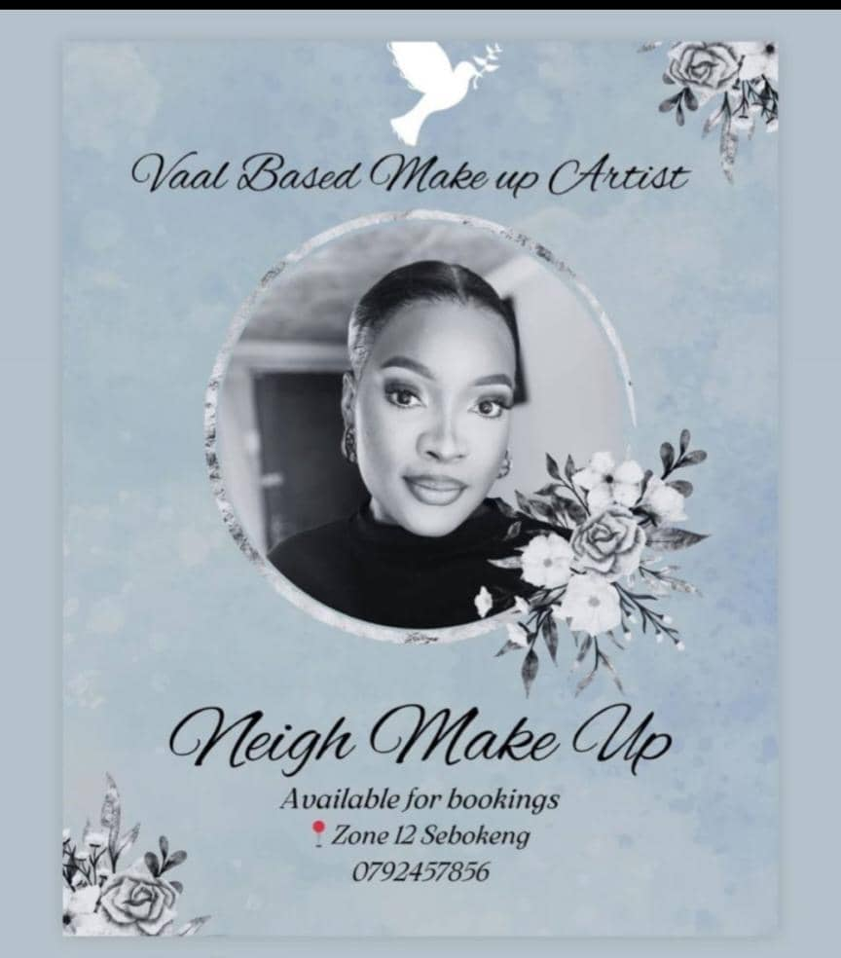
Graphic Design is emotional
Everything has a personality: everything sends an emotional signal. Even where this was not the intention of the designer, the people who view the website infer personalities and experience emotions.”

Slide 6
Softwares to use - Install
Adobe Illustrator
Adobe Photoshop
Sketch etc

Slide 7
Roles of Graphic Designer/Career paths
Junior graphic designer: A newly qualified professional who may not have much experience in a working environment.
This entry-level role may include minor work such as adjusting typefaces, correcting colour and creating logos.
Graphic Designer: Has the experience and skills to cover a wide range of responsibilities in the workplace. Typical duties for this role include working directly with clients, creating artwork independently and creating concepts for approval, with some supervision from senior staff members.
Notes:
If you're considering starting a career as a graphic designer, getting to know the career path in this profession can help you to develop your skills and work your way up to senior positions
Junior GD- Recent graduates commonly apply for junior positions following work experience or internships to allow them to gain real-world experience while under the supervision of experienced professionals.

Slide 8
Career paths cont’d
Senior Graphic Designer: Have more experience and knowledge of how to work in the visual design field. These may oversee the work of more junior employees and offer guidance and mentorship for improvement.
Have less input from management and may independently meet with clients and cover every aspect of design from conceptualisation to delivery.
Product Designer: Use their expertise to create the shape, structure and design of products sold to consumers.eg a toy company may hire a graphic designer to create artwork for the outside of the box for a toy, providing a picture to represent what the toy looks like once assembled. May work on the product's design, such as the colours used, the shape of packaging and finer, small elements of designs such as decals and minor illustrations.

Slide 9
Other roles include
Publishing designer - Those that design books, magazines, covers, news papers etc
Animation designers- creating and rigging designs for shows, movies and video games
Et- cetera

Slide 10
Roles cont’d
Website designers: Work together with graphic designers to create websites that provide a positive user experience. Graphic design artists use their skills to create header images, logos, and mock-ups of whole websites for delivery to clients. This specialised career path offers the opportunity to work with many business development teams to design and create high-quality websites from the beginning.
Brand designers: Use graphic design and marketing skills to provide corporate organisations with a clear visual identity. Marketing specialists and graphic designers typically create these branding guidelines using industry research and knowledge to create branding that appeals to the target audience. For example, you may make a new logo, select brand colours and provide information on the correct font, spacing and illustrations for specific purposes.

Slide 11
Where do graphic designers work?
Freelance graphic designers
Work directly with clients as self-employed professionals and receive pay per job. eg, as a freelancer, you may create an online portfolio and social media channel to advertise your services and encourage clients to work with you. Freelance designers may specialise in a particular industry, such as product design or branding design, or provide a comprehensive service to many sectors. Freelancers may also work for agencies on individual jobs, receiving payment from the agency for contributing to work for their clients.

Slide 12
Where do graphic designers work? cont’d
Agency graphic designers
Graphic designers working within an agency receive a direct salary while providing work for multiple clients throughout their employment. For example, on one week you may work on a single long-term project for one large client and, on another week, you may work on several smaller orders from other clients. Agency graphic designers typically work in dedicated studios or marketing agency offices, providing services to many industries and specialised sectors.

Slide 13
Where do graphic designers work? cont’d
Inhouse Graphic designers
Companies hire graphic designers to work in-house, typically in the marketing department. Graphic designers who work in-house create imagery and illustrations for one company or may supply imagery to subsidiaries or partners. For example, if a business designs a marketing campaign for social media promotions, an in-house graphic designer creates the imagery for the posts.

Slide 14


Slide 15
NEXT CLASS
ADOBE ILLUSTRATOR interface and all tools
Design building blocks Essentials

